Slide 1
Automobile Computer Security
Kyle Gehrman
Adam Hodges

Slide 2
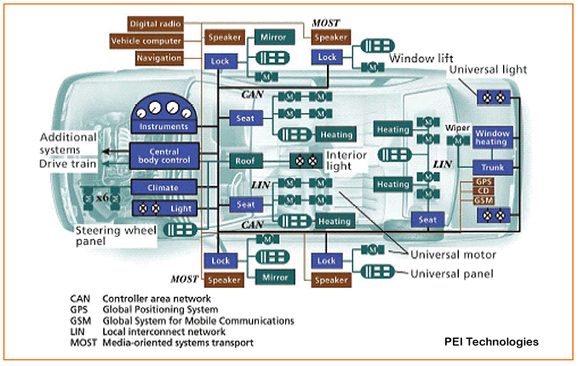
The Modern Car
  Electronic Control Unit (ECU)
  Controller Area Network (CAN)
    Found in virtually all modern cars since ~2003
Some modern cars have over 80 ECUs in the CAN

Slide 3
Accessing the CAN
  Early CANs were wired
    Assumed closed network
  More recent CANs contain wireless components
    Massive security implications
  Just how safe is a modern CAN?
    Experimental study done in 2010 by researchers at Univeristy of Washington and University of California

Slide 4
Experimental Security Analysis
  Researchers used two identical 2009 model cars
  Wrote a packet sniffer/injection tool, introduced into the CAM by simply plugging a device in to the car's federally mandated universal OBD-II diagnostics port
  Used "fuzzing" to enumerate the commands that the car responds to
  Using the commands they discovered, performed live tests to see how much of the car they could control

Slide 5
Results
  Researchers could not only fully control the car using their device, they could do it while the car was going 40 MPH
  Among the things they could control:
    Disable brakes
    Engage brakes
    Disable wipers and continuously spray fluid
    Permanently activate horn
    Kill engine
    Unlock all doors
  Also found that they could write programmatic commands, or "viruses", that would activate under certain conditions
    Disable all lights when driving over 40MPH
  Even though they had physical access to the CAN, they noted that the same commands could potentially be executed wirelessly

Slide 6
The Problem
  CAN is an insecure low-level protocol
  Every message is an unencrypted plain-text broadcast to every device on the CAN
  Possible messages and communication procedures are often documented and made available freely
  No component authentication
  Any device can send a command to any other devices.
    Atttacker could use tire pressure gauge to turn off brakes

Slide 7
The Solution
  Auto manufacturers need to recognize this security flaw in the CAM if they are using wireless ECU communication
  Controller authentication
    Only valid controllers can communicate on the CAN
  Encrypted communication
    Must be high performance, so use symmetric key
    Distribute symmetric key using asymmetric encryption during authentication
  Firewall
    Restrict a components commands to only those essential to its function

Slide 8
Conclusion
  Auto makers need to understand the seriousness of having networked car components and take security measures accordingly
  These security flaws are growing in seriousness as cars automate more and more things
    Electric steering and acceleration
  With the emergence of bluetooth connected ECUs, this is a serious security issue that cannot be ignored any longer.

Slide 9
References
Experimental Security Analysis of a Modern Automobile
http://ieeexplore.ieee.org/xpls/abs_all.jsp?arnumber=5504804&tag=1
Security in Automotive Bus Systems
http://weika.eu/papers/WolfEtAl_SecureBus.pdf
Hacking Cars
http://dl.acm.org/citation.cfm?id=2018396 (pg 18)
Highway Robbery: Car Computer Controls Could Be Vulnerable To Hackers
http://www.scientificamerican.com/article.cfm?id=wireless-car-hacking

